Slide 1

SQL Project: DVD
Rental Analysis
Shreya Purohit

Slide 2
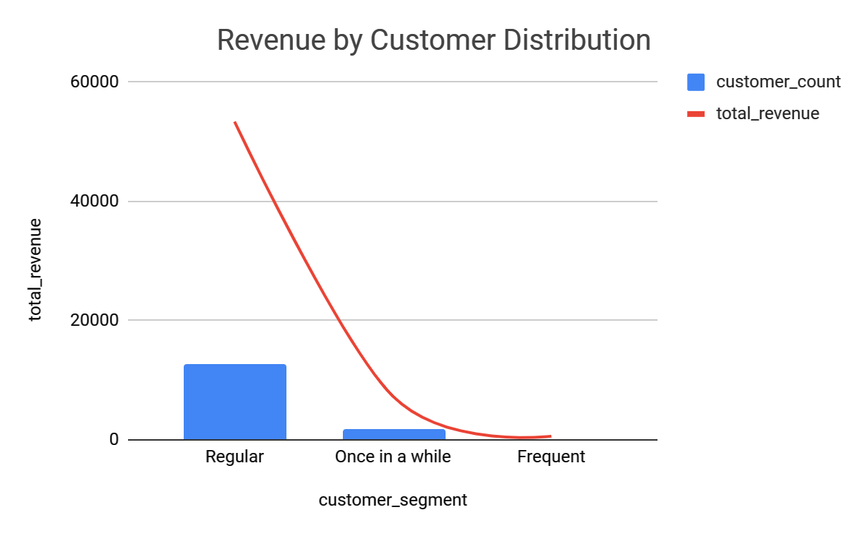
What kind of customers are the most profitable for the rental store?
As we can see, after the Regular buyers, the customers that came once in a while generated a higher total revenue compared to frequent ones. This is an interesting insight that highlights the potential of targeting new customers and promoting new releases to turn occasional customers into loyal and frequent buyers.

Slide 3
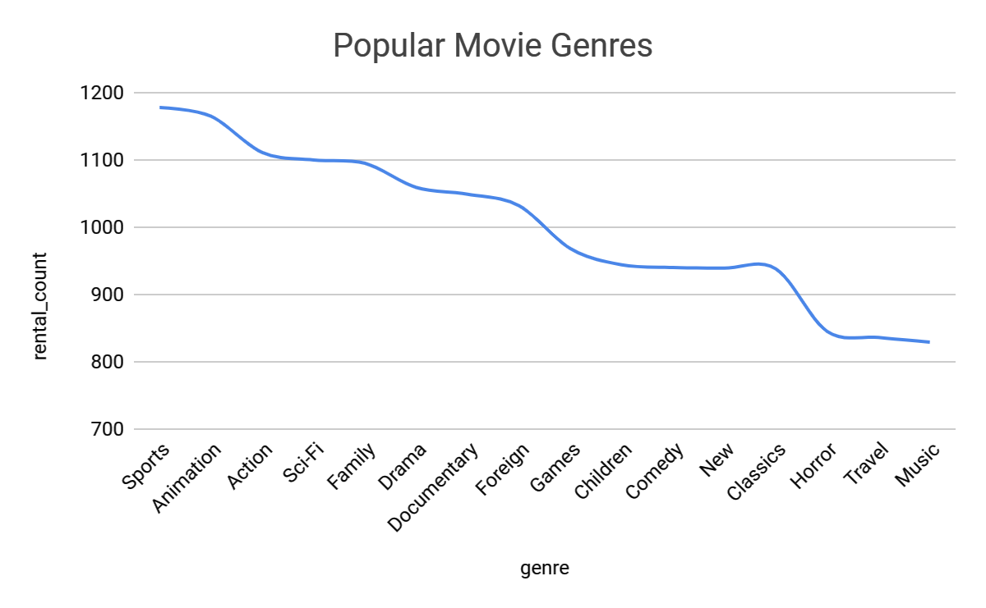
How can we use the data to recommend customers new movies, and how does this affect us as a seller?
The data shows that the Sports genre has been the most popular rental category, followed by Animation, Action, and Sci-Fi.
This can be used to make data-driven decisions as a seller, such as stocking up on these popular genres to maximize profits. It can also have a positive impact on customer satisfaction, loyalty, and retention rates.

Slide 4
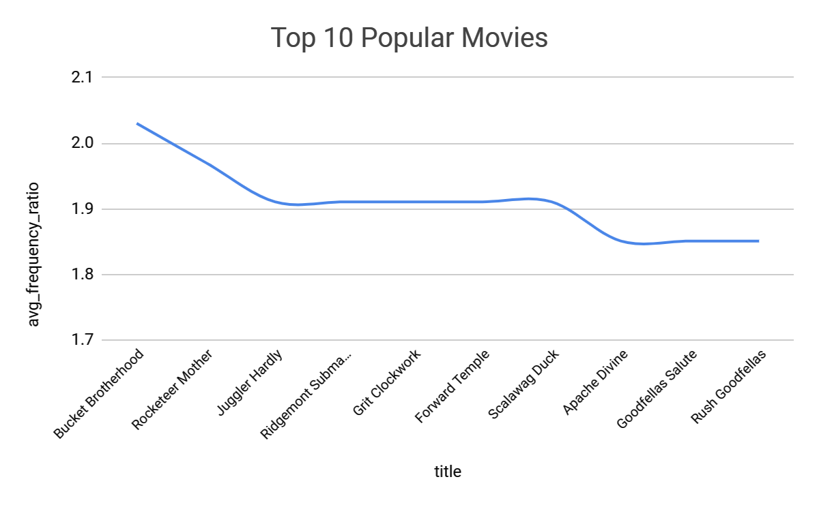
Enlist the top 10 movies that are rented the most of all time, how does it compares to the average rental rate of all the movies in the data?
The average frequency ratio shown in this visualization can help us determine the popularity of each movie compared to the average popular movie. We can use this information to determine whether they should be given more attention in terms of stocking or not on a business perspective.

Slide 5
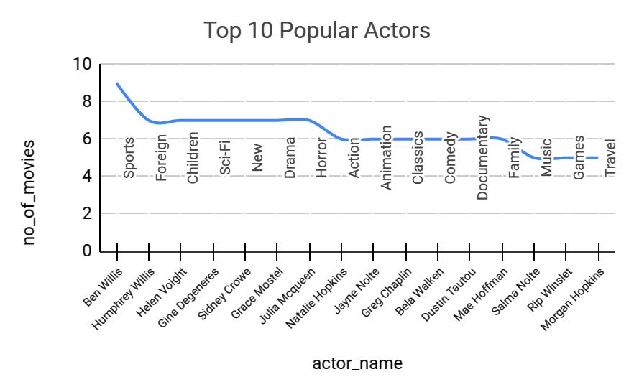
Which actors have appeared most in each category of movies?
We can see Ben Wills is most popular in Sports genre. This insight can help one understand the preferences of their customers and organise marketing campaigns targeted to specific audience. This could result in an increased customer satisfaction, as they are more likely to find movies they enjoy.

Slide 6
THANK YOU

